Slide 1

"Technology Usage & Trends Analysis Project"
Jashwanth Reddy
May 2025

Slide 2

OUTLINE:
Executive Summary
Introduction
Methodology
Programming Language Trends
Database Trends
Dashboards
Insights from Dashboards
Overall Findings & Implications
Conclusion
Appendix

Slide 3

EXECUTIVE SUMMARY:
Current Technology Usage
This analysis highlights the most widely used programming languages, databases, and platforms in today’s technology landscape.
Key technologies such as Python, JavaScript, PostgreSQL, and MySQL dominate due to their versatility and ecosystem support.
Adoption patterns vary across industries, with open-source tools leading in startups and relational databases remaining central in enterprise environments.
Future Technology Trends
This section explores the emerging technologies expected to gain traction over the next year.
Languages like Rust, TypeScript, and platforms such as Firebase and Snowflake are forecasted to see increased adoption.
The shift toward cloud-native and real-time data solutions indicates a growing need for scalable and flexible architectures.
Demographic Insights
The demographic analysis provides a global view of tech professionals’ age groups, educational backgrounds, and geographic distribution.
Younger developers (ages 18–29) are more likely to adopt newer languages like Rust and TypeScript.
A strong correlation exists between higher education levels and proficiency in emerging technologies, especially in North America and Europe.

Slide 4

INTRODUCTION:
Purpose of the Report:
This report analyzes current and emerging technology trends using industry and survey data. It highlights the most widely used and in-demand programming languages, platforms, and tools, while also profiling the demographics of technology professionals.
Target Audience:
Technology Professionals: Align skills with market demand.
Employers & Recruiters: Identify top tech competencies.
Educators & Institutions: Adjust curricula to reflect industry needs
Value of the Report:
Supports career planning and skill development
Informs strategic hiring and workforce planning
Guides curriculum design and technical training programs

Slide 5

METHODLOGY:
Data Overview
Analysis is based on responses from the survey_data_updated.csv dataset, collected via an online developer survey.
Survey covered:
Current technology usage
Preferred future technologies
Demographic details (age, country, education, etc.)
Analysis Approach
Focused on languages, databases, platforms, and web frameworks.
Visualized trends and insights using:
Stacked bar/column charts
Word clouds
Scatter bubble charts
Treemaps
Geographical map charts

Slide 6
METHODOLOGY:
Data Wrangling
Cleaned null values, standardized category labels
Converted formats (e.g., multiple-choice to binary flags)
Grouped variables for interpretability (e.g., age ranges, region clusters)
Evaluated demographics with:
Pie charts
Stacked bars
Line/bar combos
Geo-mapped distributions
Outcome
Enabled the identification of popular tools, rising technologies, and correlations between tech usage and demographic traits.

Slide 7
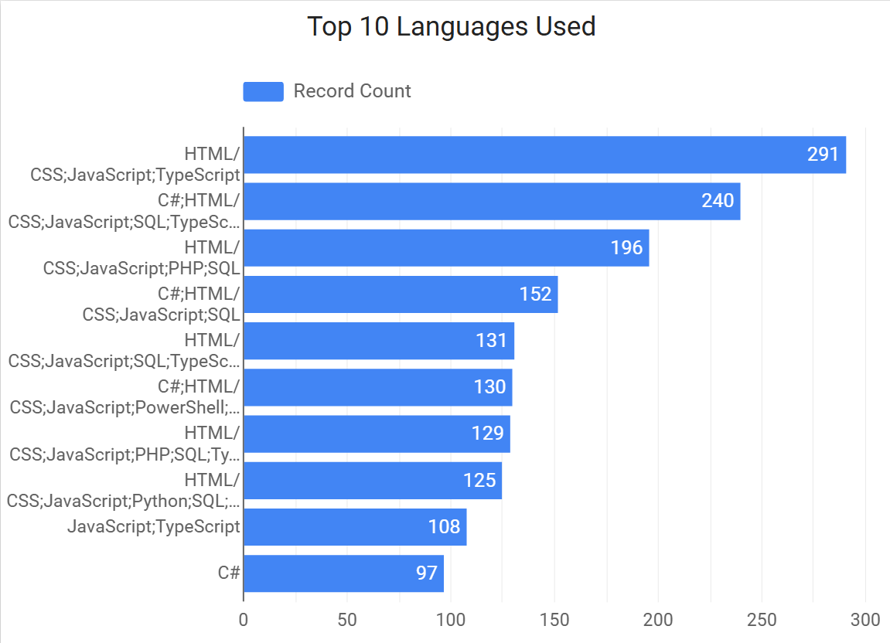
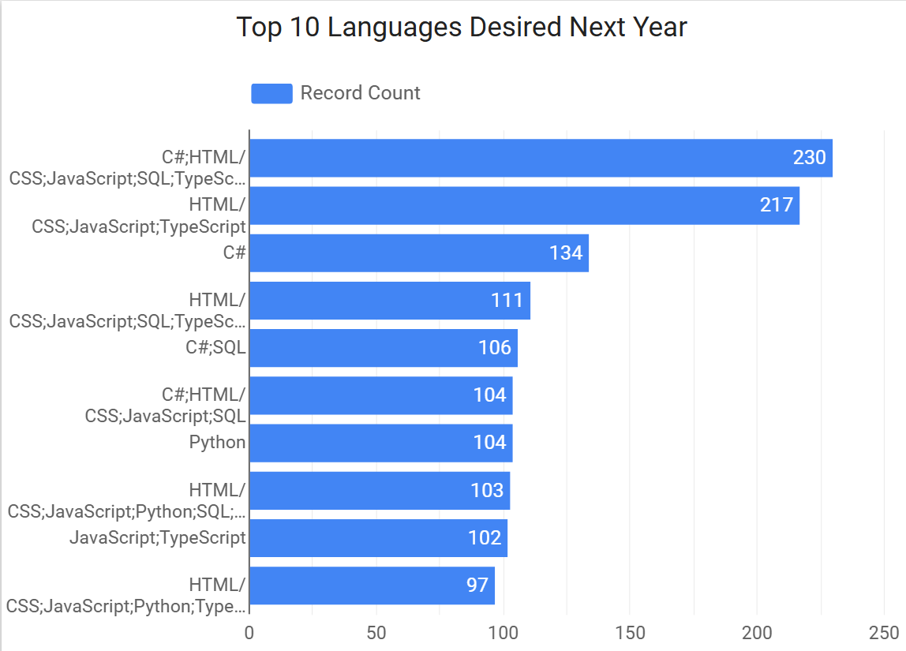
PROGRAMMING LANGUAGE TRENDS:
Current Year
Next Year

Slide 8
PROGRAMMING LANGUAGE TRENDS - FINDINGS & IMPLICATIONS:
Findings
Shift Toward Full-Stack Language Combinations Developers are increasingly blending front-end and back-end languages (e.g., JavaScript + Python or Node.js + SQL).
Decline in Single-Language Dominance Pure front-end stacks or single-language usage (e.g., only JavaScript or only PHP) are decreasing in popularity.
Rising Interest in Python Python continues its ascent across domains—AI, data science, web development—making it a core skill across industries.
Implications
Focus Training on Full-Stack Skills Tech teams and L&D departments should emphasize full-stack development in upskilling programs.
Revamp Curricula for Relevance Bootcamps and academic programs should integrate combined-stack learning (e.g., MERN + Python backend).
Align Tech Strategy with Backend Growth Strategic IT planning must anticipate higher demands for backend scalability, API development, and server-side performance.

Slide 9
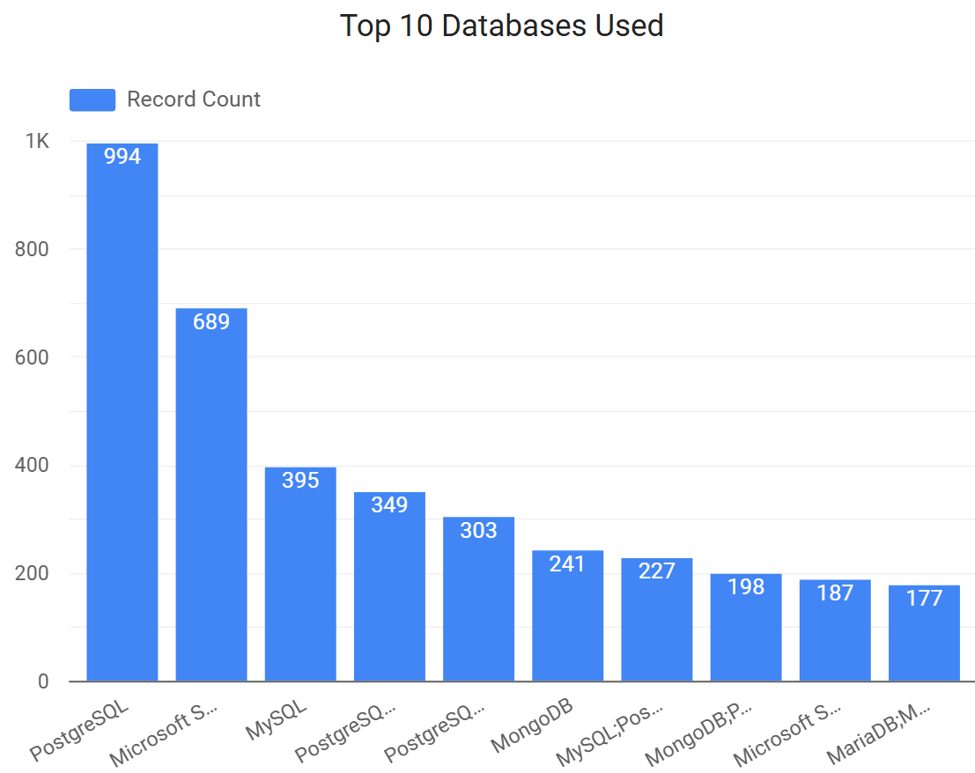
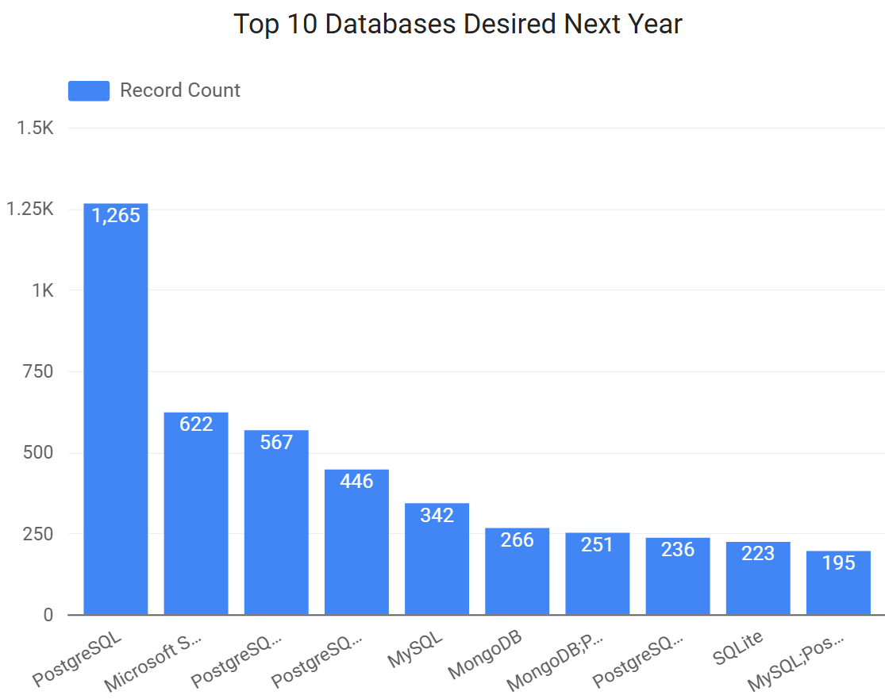
DATABASE TRENDS
Current Year
Next Year

Slide 10
DATABASE TRENDS - FINDINGS & IMPLICATIONS
Findings
PostgreSQL Dominance is Growing Increasingly adopted across industries for its robustness, scalability, and open-source nature.
Microsoft SQL Server Faces a Slight Dip A modest decline in usage, likely due to cloud-native and open-source alternatives gaining traction.
Rise in Popularity of Diverse Databases Broader adoption of NoSQL, document, and real-time databases (e.g., MongoDB, Redis, Firebase) to meet specific use cases.
Implications
PostgreSQL Should Be a Strategic Focus Organizations should invest in PostgreSQL expertise and optimization for long-term flexibility and cost-effectiveness.
Modernize Legacy Microsoft SQL Systems Enterprises must evaluate modernization paths or hybrid setups to stay competitive and cloud-ready.
Broadened Tech Stack Support is Essential Teams need to accommodate multiple database types (SQL + NoSQL) for performance, scalability, and specialized workloads.

Slide 11
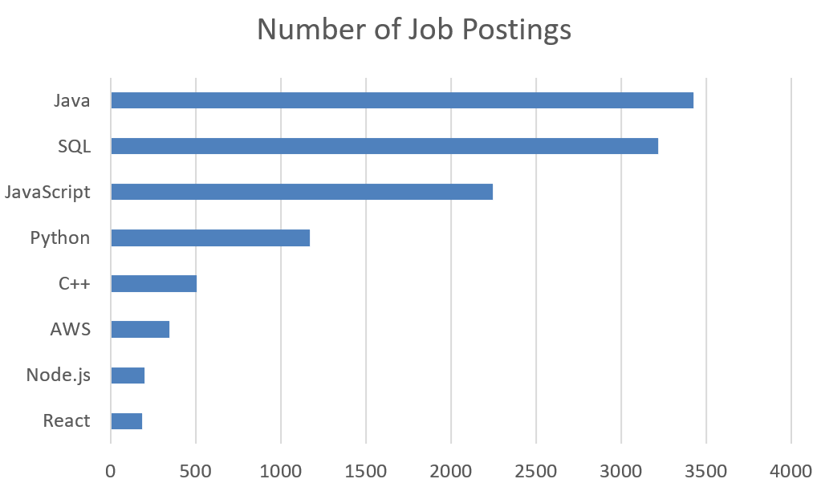
JOB POSTINGS:

Slide 12
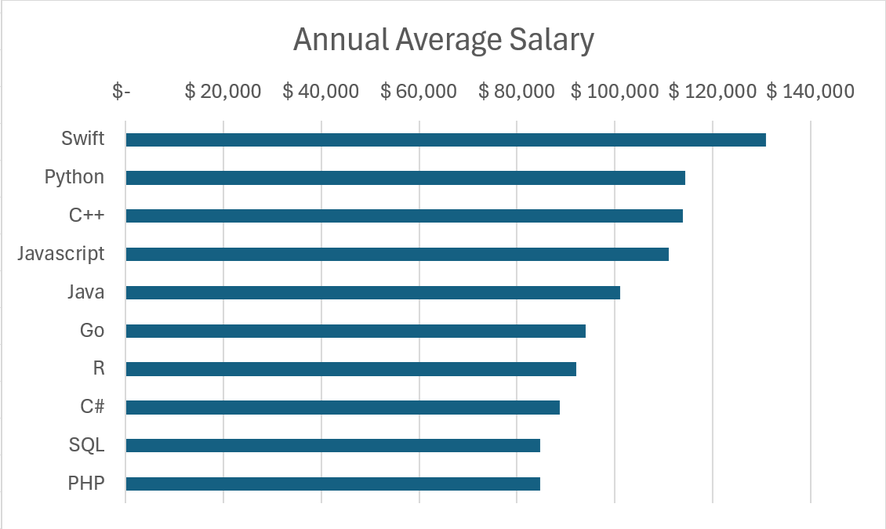
POPULAR LANGUAGES:

Slide 13

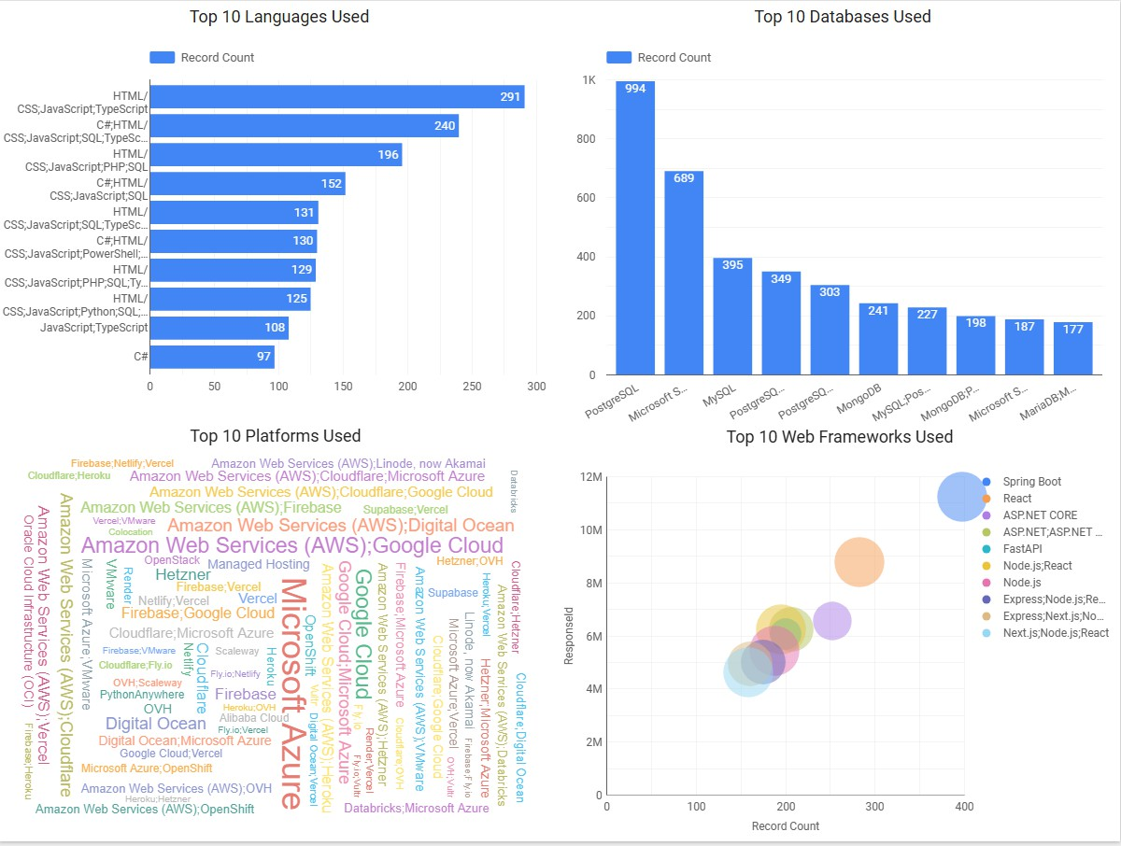
DASHBOARD TAB 1:

Slide 14
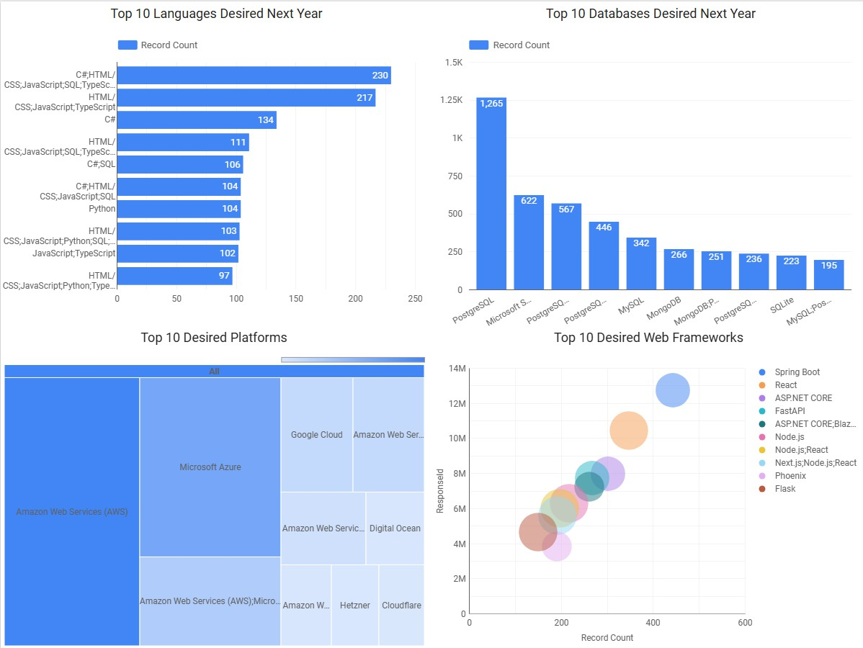
DASHBOARD TAB 2:

Slide 15
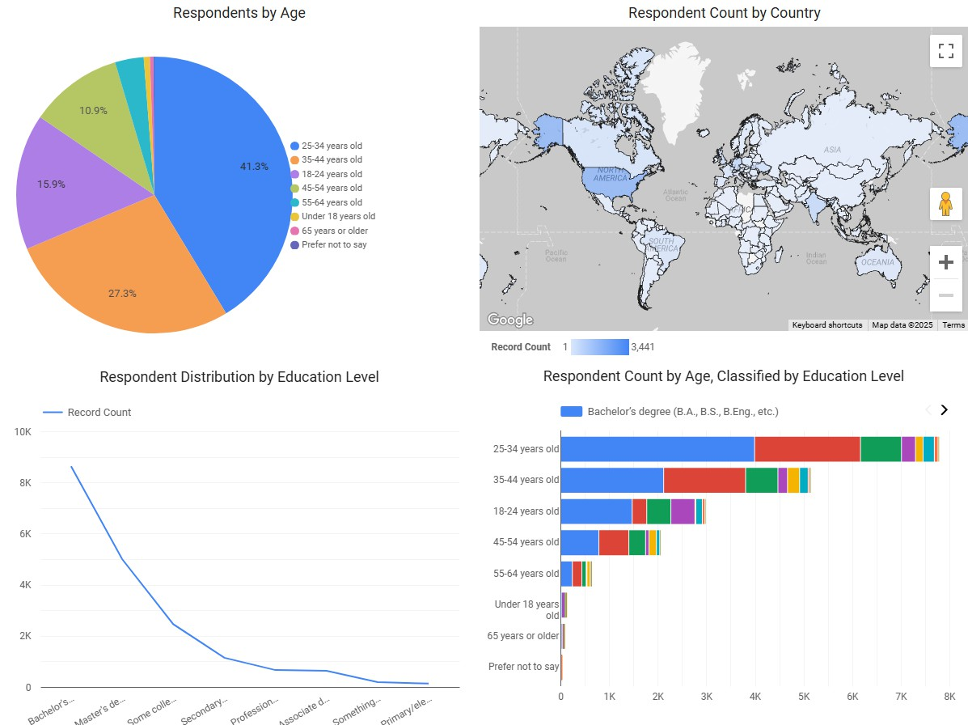
DASHBOARD TAB 3:

Slide 16

DISCUSSION:
Current Technology Usage
Developers often use HTML, CSS, JavaScript, and TypeScript together, showing strong full-stack trends.
PostgreSQL is the most used database, followed by Microsoft SQL Server and MySQL.
AWS is the leading cloud platform, with Google Cloud and Azure also widely used.
Spring Boot, React, and Node.js are popular web frameworks.
Future Technology Trends
Developers want to work with full-stack combinations like C#, JavaScript, SQL, and TypeScript.
PostgreSQL remains the most preferred database for future use.
AWS and Azure are the top choices for future cloud platforms.
Spring Boot, React, ASP.NET Core, and FastAPI are in high demand.
Demographics
Most developers are aged 25–34, followed by 35–44.
A majority have at least a bachelor’s degree.
Respondents are mainly from North America, Europe, and Asia.

Slide 17
OVERALL FINDINGS & IMPLICATIONS:
Findings
PostgreSQL and HTML/CSS/JavaScript are top technologies in current use.
There's a clear shift toward versatile, full-stack skill sets.
Growing demand for open-source and scalable technologies.
Implications
Training and upskilling should focus on open-source tools and scalable platforms.
Employers will prioritize candidates with hybrid (front-end + back-end) skills.
Legacy systems must be evaluated for modernization and integration.

Slide 18

CONCLUSION:
The industry is shifting toward open-source, cloud-ready technologies and versatile programming skill sets.
PostgreSQL’s rise reflects demand for scalable, cloud-native databases, aligning with digital transformation trends.
Strong use of HTML, CSS, JavaScript, and TypeScript highlights the ongoing importance of full-stack and front-end development.
There is growing demand for multi-database experience and hybrid developer roles, emphasizing the need for adaptability.
Educators should train students for multidisciplinary roles.
Employers must update job criteria to reflect evolving tech stacks.
Embracing these trends is essential to stay competitive in a rapidly changing tech landscape.

Slide 19

APPENDIX:
Extra Charts & Visuals
Language trends over time (Python, TypeScript, C#)
Database usage by region
Cloud platform vs. developer experience
Data Preparation
Removed missing values
Standardized category names
Converted multi-choice answers
Grouped demographics (age, education)
Files Used
survey_data_updated.csv
Python analysis scripts
Dashboards from Cognos / Looker Studio
Additional Notes
Combined current and future data for better insights
Connected trends to demographics for deeper context

